Slide 1

Technologies enabling cloud computing

Slide 2
Cloud computing technologies
Virtualization
Load balancing
Programming models
Cloud storage

Slide 3
Intended learning outcomes
After completing this topic, you will be able to:
Discuss system, network and storage virtualization and outline their role in enabling the cloud computing system model
Discuss issuea of load balancing
Analyze various cloud programming models and apply them to solve problems on the cloud
Illustrate the fundamental concepts of cloud storage and demonstrate their use in storage systems

Slide 4
MapReduce summary
MapReduce system mainly consists of three modules
Client
Master
Worker
The client is responsible for submitting parallel processing assignments composed by the users to master node;
Master node will automatically decompose user’s task into Map missions and Reduce missions, and delivered to worker nodes;
Worker nodes request to the master node for the work tasks
The distributed file system consisting of many worker nodes will be used for storing input and output data of MapReduce.

Slide 5
Cloud computing technologies
Virtualization
Load balancing
Programming models
Cloud storage

Slide 6
For cloud computing to work, we need some kind of networked storage solution
Let us first have a look at some traditional networked file system to see why new file systems were needed

Slide 7
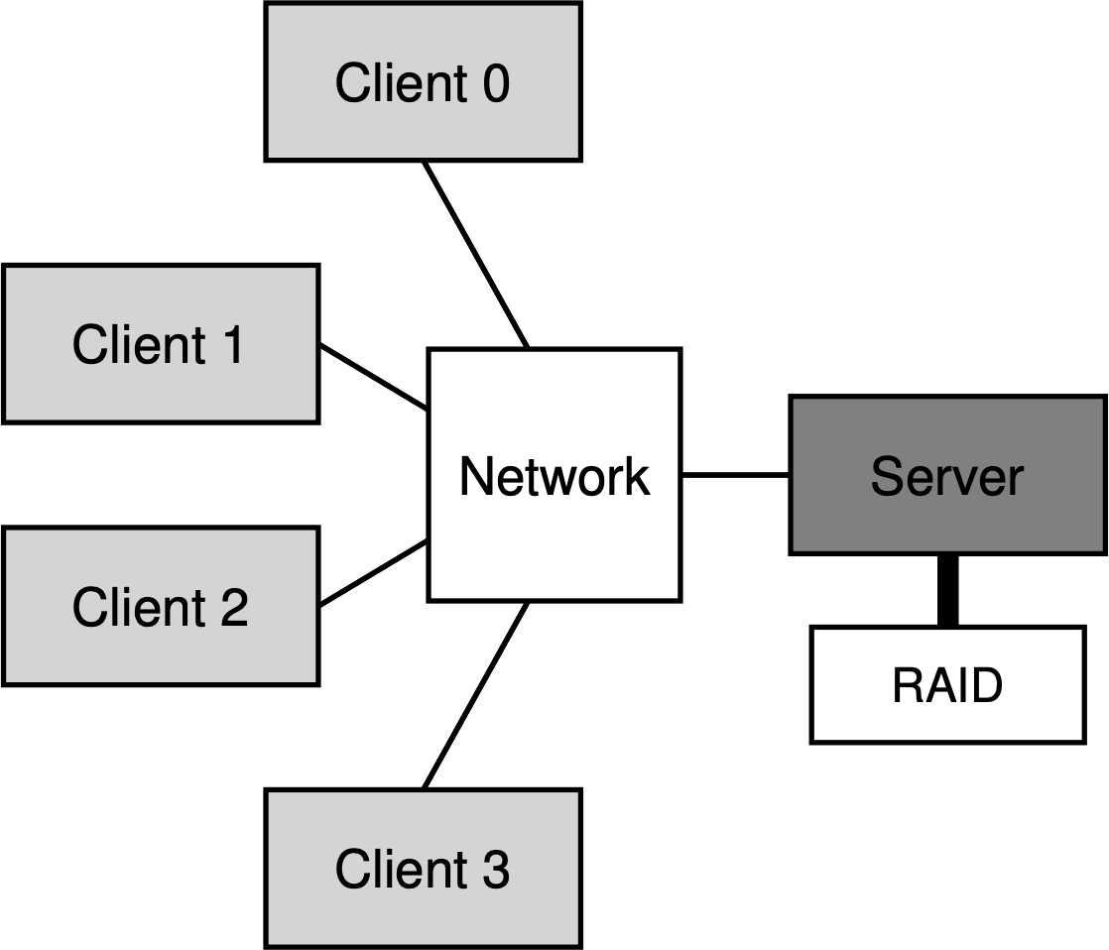
Networked File Systems
Goal: Make files accessible over network
Client/Server architecture
Network File System (NFS), Sun, 1986
Andrew File System (AFS), CMU, 1988
Challenge: How to reduce network transfers?
Client-side caching
Consistency Model
RAID is a way of storing the same data in different places - a data storage virtualization technology that combines multiple physical disk drive components into one or more logical units
data redundancy
performance improvement

Slide 8
Networked File Systems – problems
Server becomes a bottleneck
Can’t store files larger than the capacity of single server
Server becomes a single point of failure
Server down => all files owned by it unavailable
Capacity under-utilization

Slide 9
“Distributed” File Systems
Ideally: File should not be bound to single machine
“Serverless” Distributed File Systems
File data + metadata split across multiple machines
Redundancy across machines
Recovery + load balancing transparently handled

Slide 10
Shortcomings of previous systems
None designed for their failure model
Few scale as highly or dynamically and easily
Lack of special primitives for large distributed computation

Slide 11
Motivation: Large Scale Data Storage
Manipulate large (Peta Scale) sets of data
Large number of machine with commodity hardware
Component failure is the norm
Goal: Scalable, high performance, fault tolerant distributed file system

Slide 12
Two important distributed file systems
At Google, MapReduce operation are run on a special file system called Google File System (GFS) that is highly optimized for this purpose.
GFS is not open source
Doug Cutting and Yahoo! reverse engineered the GFS and called it Hadoop Distributed File System (HDFS)
The software framework that supports HDFS, MapReduce and other related entities is called the project Hadoop or simply Hadoop
This is open source and distributed by Apache

Slide 13
Why build GFS?
Built by Google, for Google
Google’s use-case: Large-scale data processing workloads
Data: crawled documents, search logs etc..
Clusters: 100s-1000s of machines w/ commodity hardware
MapReduce jobs (distributed computing framework)
Why not use existing systems?
Older DFS don’t scale

Slide 14
GFS Components
Master (NameNode)
Manages metadata (namespace)
Not involved in data transfer
Controls allocation, placement, replication
Chunkserver (DataNode)
Stores chunks of data
No knowledge of GFS file system structure
Built on local linux file system

Slide 15
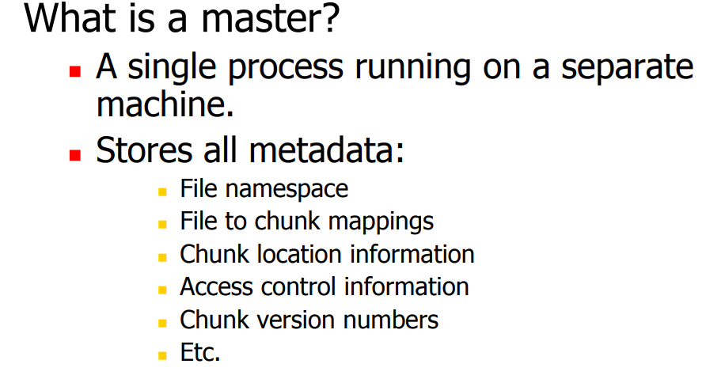
GFS Components
Master (NameNode)
Manages metadata (namespace)
Not involved in data transfer
Controls allocation, placement, replication
Chunkserver (DataNode)
Stores chunks of data
No knowledge of GFS file system structure
Built on local linux file system

Slide 16
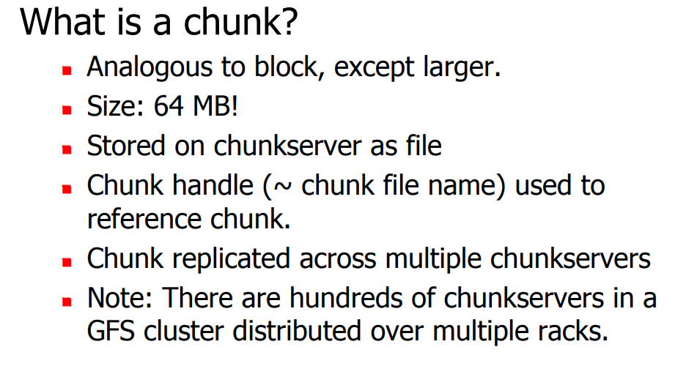
GFS Components
Master (NameNode)
Manages metadata (namespace)
Not involved in data transfer
Controls allocation, placement, replication
Chunkserver (DataNode)
Stores chunks of data
No knowledge of GFS file system structure
Built on local linux file system

Slide 17
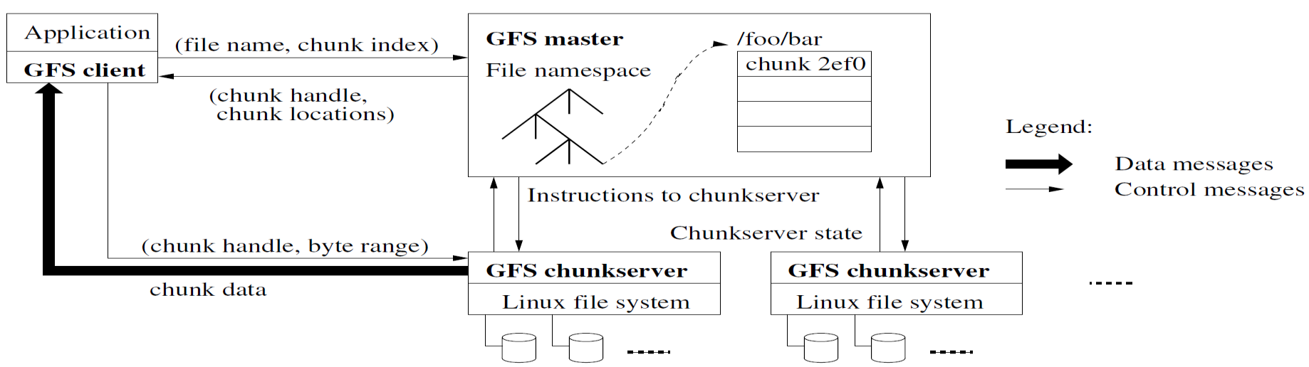
GFS Architecture

Slide 18
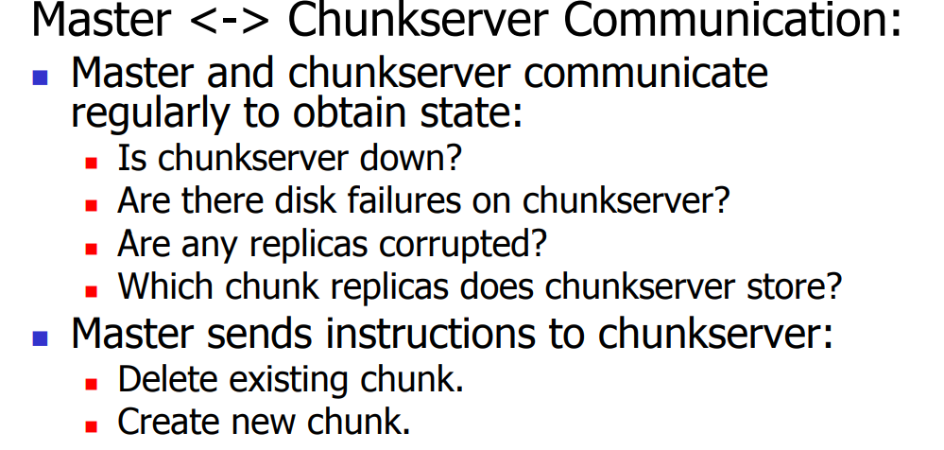

Slide 19
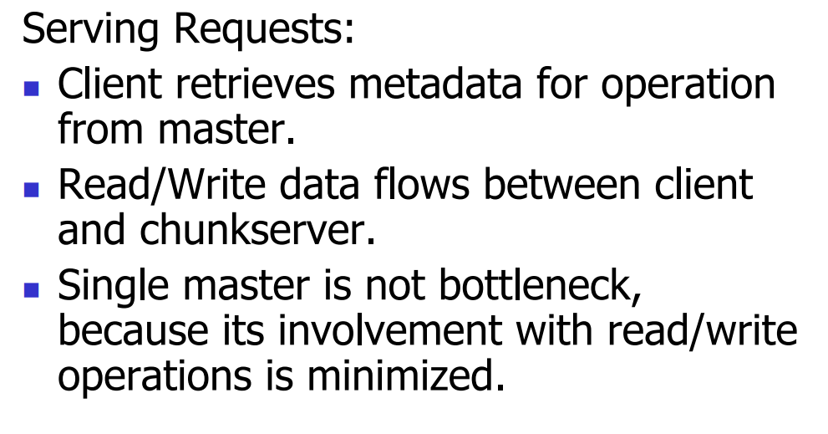

Slide 20
Interface
Familiar file system interface
create, delete
open, close
read, write
Additional operations
Snapshot - creates a copy of a file or a directory tree at low cost
Record Append - allows multiple clients to append data to the same file concurrently while guaranteeing the atomicity of each individual client’s append.

Slide 21
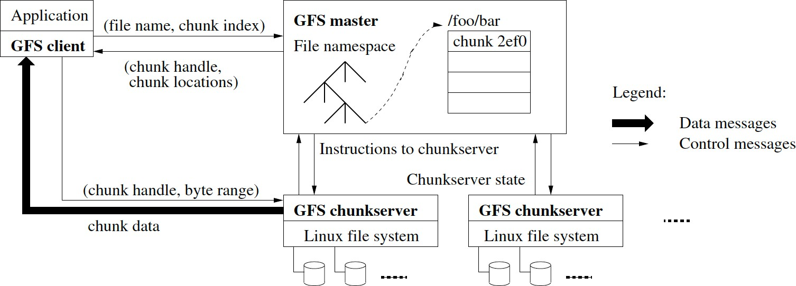
Read Path
Clients cache chunk locations
No client-side data caching!

Slide 22
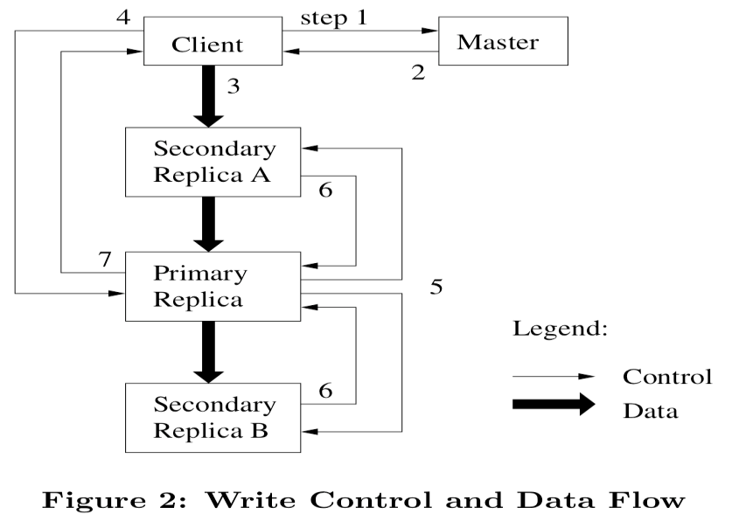
Write operation
Client contacts Master
Master replies w/ location of primary and other replicas
Client pushes data to all replicas; replicas buﬀer received data
Client sends write request to primary; primary serializes requests
Primary applies request, forwards to secondaries in serial order
Secondaries send Ack to primary
Primary sends Ack to client

Slide 23
Write(filename, offset, data)
4) Commit
1) Who has the lease?
Master
Client
2) Lease info
3) Data push
Primary Replica
Control
7) Success
Data
3) Data push
6)Commit ACK
Secondary ReplicaA
5) Serialized Commit
3) Data push
6)Commit ACK
Secondary ReplicaB

Slide 24
Impact of GFS
Inspired Append-only file systems
Ex: HDFS, Microsoft’s COSMOS
No support for byte-oﬀset writes, only appends (cleaner)
SIGOPS Hall of Fame Award 2015
Most influential systems paper in last 10 years

Slide 25
Apache Hadoop
A collection of open-source software utilities that facilitates using a network of many computers to solve problems involving massive amounts of data and computation
It provides a software framework for distributed storage and processing of big data using the MapReduce programming model

Slide 26
Basic Features of HDFS
Highly fault-tolerant
High throughput
Suitable for applications with large data sets
Streaming access to file system data
Can be built out of commodity hardware

Slide 27
Hadoop Distributed File System
HDFS Server
Master node
HDFS Client
Application
Local file system
Block size: 2K
Name Nodes
Block size: 128M
Replicated

Slide 28
Hadoop Distributed File System
HDFS Server
Master node
blockmap
HDFS Client
heartbeat
Application
Local file system
Block size: 2K
Name Nodes
Block size: 128M
Replicated

Slide 29
Implementing programmes in Hadoop
The Hadoop framework itself is mostly written in the Java programming language, with some native code in C and command line utilities written as Shell scripts
Though MapReduce Java code is common, any programming language can be used with Hadoop Streaming to implement the map and reduce parts of the user's program

Slide 30
Hadoop applications
MapReduce jobs
Non-MapReduce applications
HBase database (a column-oriented non-relational database management system that runs on top of Hadoop Distributed File System)
Apache Mahout machine learning system
Apache Hive data warehouse
Theoretically, Hadoop could be used for any workload that is batch-oriented rather than real-time, is very data-intensive, and benefits from parallel processing

Slide 31
Commercial applications of Hadoop
Log or clickstream analysis
Marketing analytics
Machine learning and data mining
Image processing
XML message processing
Web crawling
Archival work for compliance, including of relational and tabular data

Slide 32
Summary
Virtualization and its role in enabling the cloud computing system model
Load balancing issues in the cloud
Cloud programming models
The fundamental concepts of cloud storage

